Slide 1
CONNECTING DEVICES
LANs do not normally operate in isolation they are connected to one another or to the Internet
To connect LANs, or segments of LANs, we use connecting devices
Topics discussed in this section :
1.Passive Hub
2.Repeater and Active hub
3.Bridges and Two-Layer Switches
4.Routers and Three-Layer Switches
5.Gateways

Slide 2

CONNECTING DEVICES
Connecting devices divided into five different categories based on the layer in which they operate in a network.:
1.Below the physical layer: passive hub
2.At the physical layer: repeater or active hub
3.At the physical and data link layers: bridge or two-layer switch
4.At the physical, data link, network layers: router or three-layer switch
5.At all five layers: gateway

Slide 3
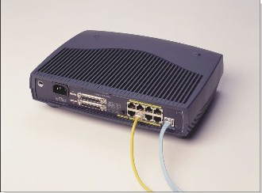
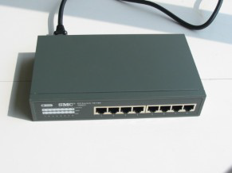
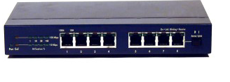
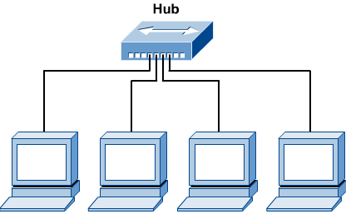
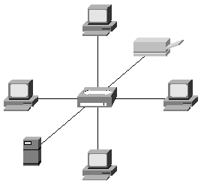
Passive Hubs

Slide 4
Passive Hubs
Passive hub is just a connector.
In a star-topology Ethernet LAN, it is just a point where signals coming from different stations collide.
The hub is the collision point.
This type of hub is part of the media
its location in the Internet model is below the physical layer.

Slide 5
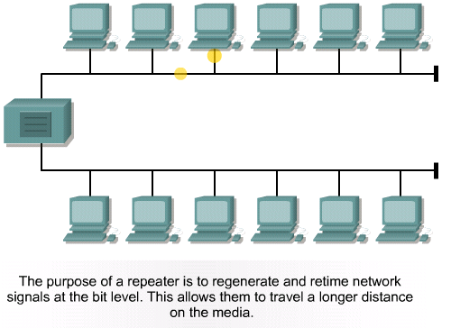
repeater

Slide 6
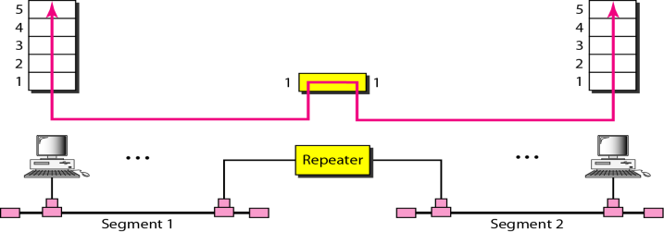
repeater
A repeater operates only in the physical layers
Can extend the physical length of a LAN
Receive the signal before it becomes too weak or corrupted and regenerates the original bit pattern
Do not actually connect two LANs
connects two segments of the same LAN
segments connected are still part of one single LAN
A repeater cannot connect two LANs of different protocols

Slide 7
repeater
Repeaters is a regenerator, not an amplifier
Amplifier | Repeater
Cannot discriminate between the intended signal and noise. It amplifies equally everything fed into it | regenerates the signal receives a weakened or corrupted signal, creates a copy, bit for bit, at the original strength
➔

Slide 8

Note
A repeater connects segments of a LAN.
A repeater forwards every frame; it has no filtering capability.
A repeater is a regenerator, not an amplifier.
10.

Slide 9

Active Hub
Actually a multiport repeater
Used to create connections between stations in a physical star topology
Can also be used to create tree topology to removes the length limitation of 10Base -T (100 m)

Slide 10
Bridge
Operates in both the physical and the data link layer
physical layer : regenerates the signal
data link layer : check the physical (MAC) addresses (source and destination) contained in the frame
Bridge has filtering capability, but repeaters has not.
checks the MAC (physical) address of the destination when receives a frame, and decide if the frame should be forwarded or dropped
forwards the new copy only to the segment (specific port) to which the address belongs
bridge has a table that maps addresses to the port.

Slide 11

Bridge : filtering
Bridge has a table to:
Maps address to ports.
Used in filtering decisions.

Slide 12
Two-Layer Switch
Performs at the physical and data link layers.
Is a bridge with many ports (multi port bridge) Design that allows better (faster) performance
No collision
Filtering based on the MAC address of the frame it received (like bridge)
Builds switching table by “learning” MAC host addresses from source addresses of incoming packets
Unknown destination addresses are flooded out other ports
Broadcast frames are flooded out other ports.
have been designed to forward the frame as soon as they check the MAC addresses in the header of the frame( first 6-bytes).

Slide 13

Routers
Three-layer devices that routes packets based on their logical addresses (IP)
Connects LANs and WANs in the Internet.
Has a routing table that is used for making decisions about the route.
Routing table are dynamic and updated using routing protocol.
Builds routing table by neighbor routers using routing protocols

Slide 14
Three layer switch
Is a router, but a faster and more sophisticated.
•The switching fabric in a three-layer switch allows faster table lookup and forwarding.
•We can use the terms router and three-layer switch interchangeably.

Slide 15
Gateway
Normally a computer that operates in all five layers of the Internet or seven layers of OSI model.

